Slide 1
Course Overview
STAT7500 – Statistical Programming
Prof. Posner

Slide 2

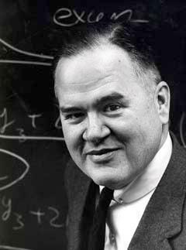
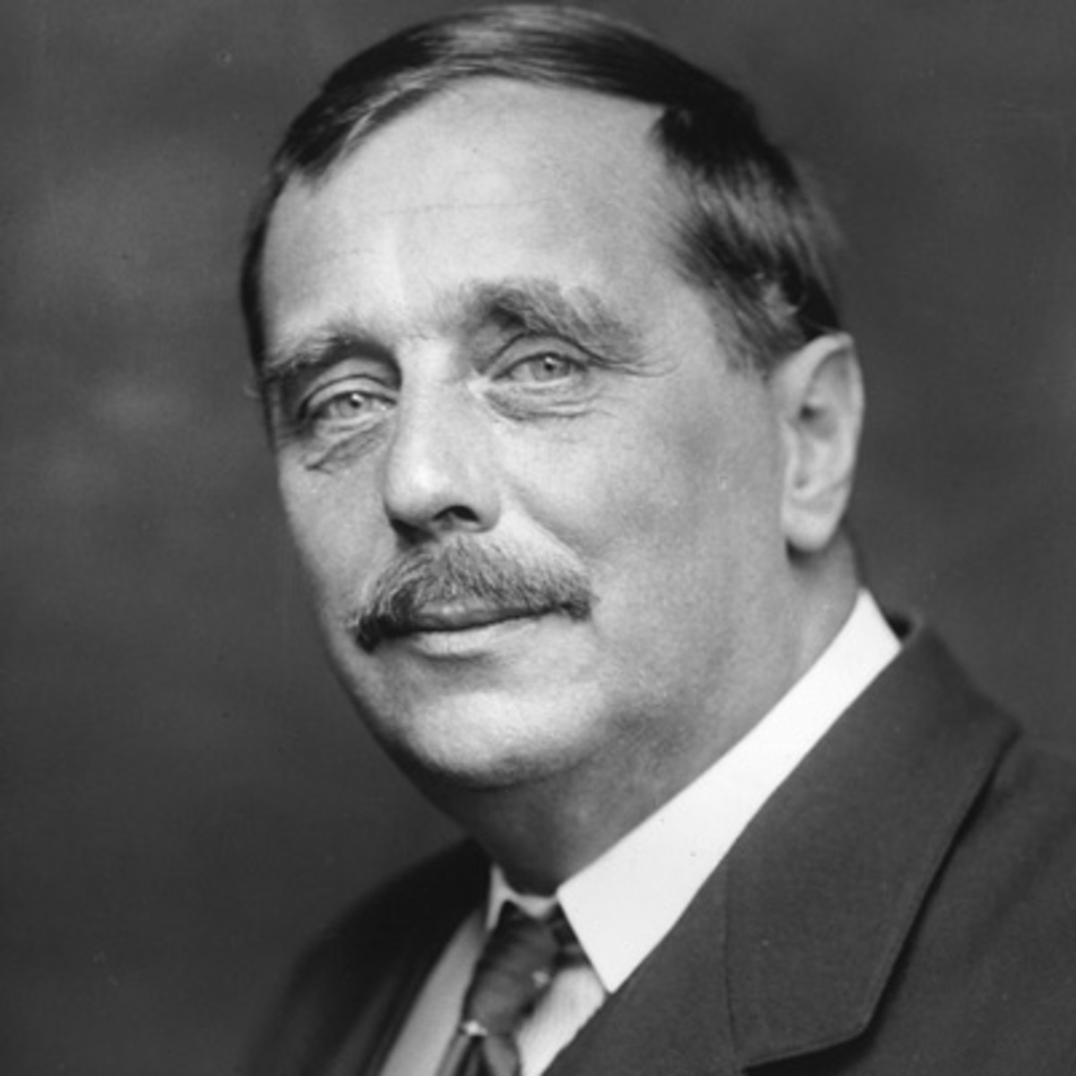
About Me
Villanova University
Professor of Statistics and Data Science
Director, Center for Statistics and Data Science Education
3rd Grade – Predicted to be a Math Teacher
BA (URoch), MS (CMU), PhD (BostonU) in Statistics
Why Statistics?
Driven by applications and discovery
Tukey: “My favorite part of being a Statistician
is that I get to play in everyone else’s backyard”
H. G. Wells: “Statistical thinking will one day be as necessary for efficient citizenship as the ability to read and write”
Research and Consulting
Stat/DS Education (Attitudes)
Causal Inference
Other fun facts…
Statistics videos – Stats Can Be Cool & How Far He’ll Go, Commencement 2020
Medicare / Insurance Fraud
Statistical Consulting

Slide 3
Who Are You?
Name and Nickname, if any
Home city (US) or country (non-US)
Which program (and if ASDS) and track are you in?
What did you study as an undergraduate? From which university?
Why are you getting this degree (or taking this course)?
One interesting fact about you

Slide 4
Syllabus Highlights
Textbook - None. We will use lecture notes and online material.
Grades
5% Attendance & Participation
20% Homeworks (graded for completion, not accuracy)
75% Three Mini-Projects (SAS, R Data Viz, R Data Wrangling)
Office Hours - Tue 5-≤6pm, (Some) Mon 5-6pm, or by appointment
Course schedule – tentative
Classroom etiquette – be polite
Absence – You are responsible for missed work, arrange in advance
Academic integrity – don’t cheat!
Learning support – Arrange in advance, contact info on syllabus
AI – All work you do must be your own – cite it when you use it
Laptops – Please bring your laptop each week
Course website - Blackboard
Notes:
F2F - Add 10) bring your laptop each class some days?

Slide 5
In This Class, We Will…
Use SAS to read in, format, and manipulate data
Use R (Quarto, tidyverse) for data visualization & data wrangling
We will focus more on R. STAT 7500 alternates its focus between SAS and R.
Talk about the disciplines of statistics and data science
Reinforce statistical thinking, especially dealing with multivariate data and discussing how choices you make about data processing affect bias
Empower you to use data in new ways in your projects, be they for an elective class or at work or in your future statistical consulting
Learn from each other

Slide 6
In This Class We Will NOT…
Prove that one language is superior to the other in all situations
…but periodically discuss pro/cons of each one
Cover statistical modeling
Learn how to deal with the complexity of every dataset or every topic you would want to know to be a professional programmer…
…but hopefully inspire you to learn more and provide you with resources on where to find answers to some of your questions
Find you a job…but this class will teach in-demand skills

Slide 7

Why Programming?
Seven recommendations for graduate programs in statistics (from ASA)
#1: Solid foundation in methods & theory
#2: Programming skills are critical
Communication, Teamwork, Non-routine problems, Immersive work experience, Periodic program updates
2021 Special Issue of the Journal for Stat & DS Education
Inspired by seminal article “Computing in the Statistics Curricula” by Nolan, Temple Lang (2010)
See AmStatNews Article and JSDSE Special Issue, including Editorial by editors Nick Horton & Jo Hardin
“I feel like a kid in a candy store!”

Slide 8
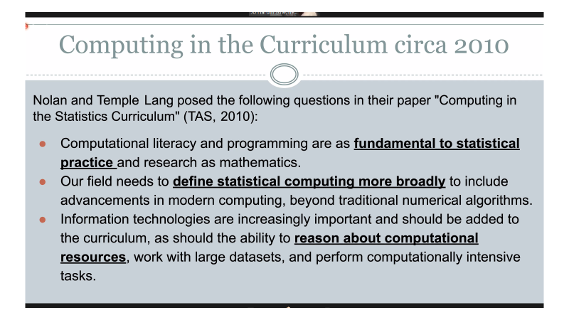
Special Issue JSDSE

Slide 9
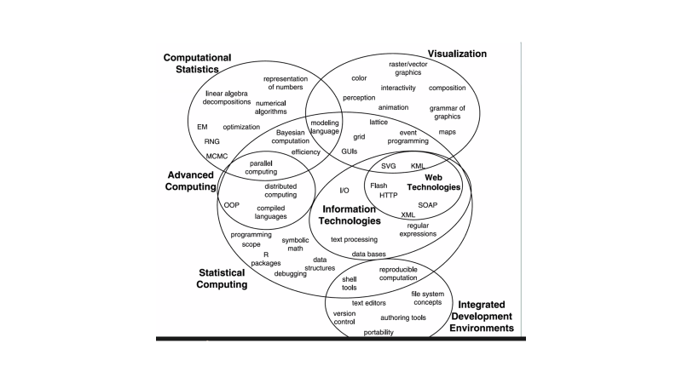
Computing in the Statistics Curriculum - Present
Notes:
We fall into Stat Computing

Slide 10
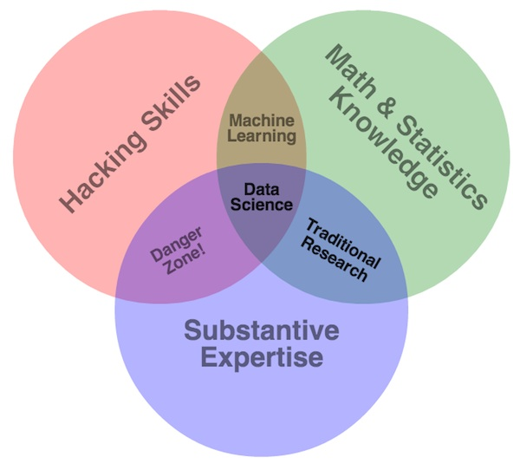
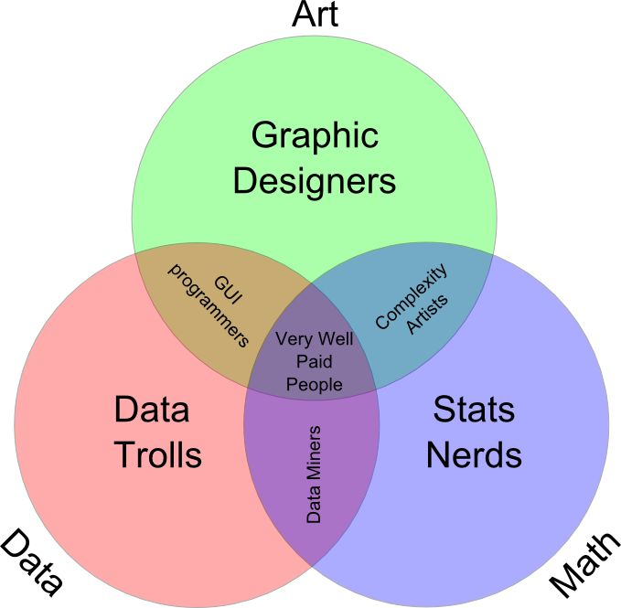
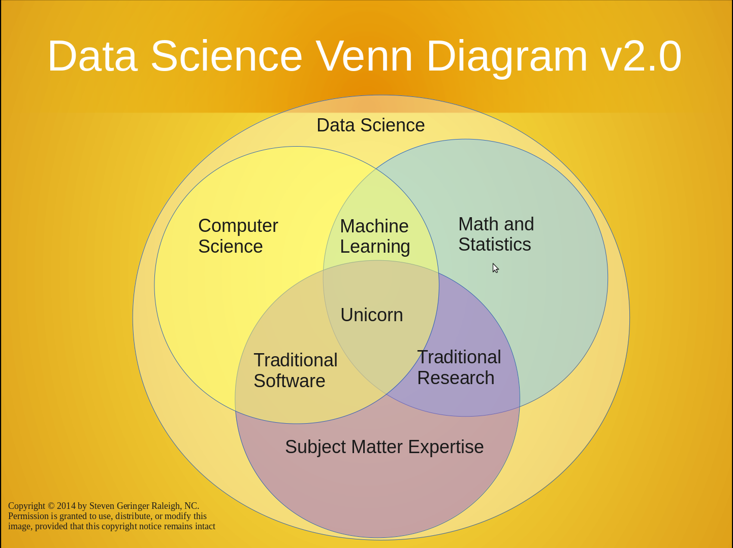
What is Data Science?
We can agree that…
…it’s the biggest user of Venn Diagrams
…otherwise, we don’t agree…

Slide 11


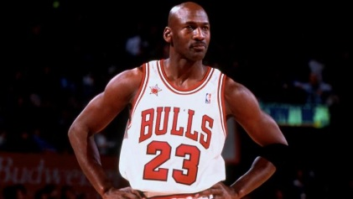

What is Data Science?
From Modern Data Science with R (Baumer, Kaplan, Horton):
The science of extracting meaningful information from data
Michael Jordan:
Computer Science is more than just programming;
it is the creation of appropriate abstractions to express
computational structures and the development of
algorithms that operate on those abstractions.
Statistics is more than just collections of estimators and tests; it is the interplay of general notions of sampling, models, distributions, and decision making.
Data Science is based on the idea that these styles of thinking support each other.
Unknown:
Turning data into knowledge and knowledge into insight.
Hadley Whickam / Hilary Parker on Statistician vs. Data Scientist (ICOTS10, 2018)
Applied Statistician – end product is a model or decision (and “story telling with data”)
Data Scientist – end product is a scalable application or viz using dynamic data sources
From Int’l Conf on Teaching Statsistics ICOTS11 (2022):
Making decisions with data is easy.
Finding evidence from data is statistics.
Type
“A” vs. “B”
What you know, you know,
what you don't know,
you don't know.
This is true wisdom.
--- Confucius
Notes:
Not Michael Jordan the BB player nor Michael B. Jordan (Erik Killmonger), but Michael I. Jordan, UC-Berkeley – Jointly appointed to ElecEng/CompSci and Stat
After Fall 2023, Make “new” an icon instead

Slide 12
What is Data Science? (DSTopics Survey)
We reviewed and categorized the definitions of data science (n=44)
26 Data -> Knowledge / Insight / Value
12 (Math) / Stat / CS
5 CS + Stat + SME
5 Skill List
4 Vague
2 Data products / scalability
1 Import -> Tidy -> xform/viz/model -> Communicate
1 Other
Preliminary & Unpublished
Notes:
Exclude from handouts?

Slide 13
What is Data Science? (Unified DS Curric)
Unified DS Curriculum Sheet
Synthesis of Professional Organization’s Recommendations
Consultation with Stat and CS Education Experts
Preliminary & Unpublished
Notes:
Exclude from handouts?

Slide 14
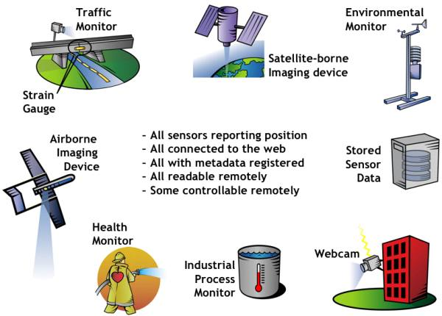

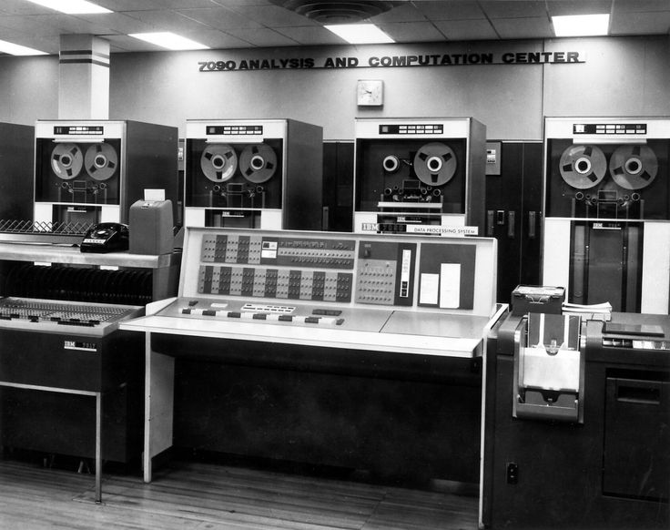


Why Such Growth?
Data are readily available
From data entry…to extraction…to sensors
In 2012, the world had created a total of less than 3 zettabytes of data
In 2018, that rose to 18 zb
In 2025, predicted 175 zb
1 zb = 10²¹ bytes = 1 trillion gigabytes
If you attempted to download 175 zettabytes at the average current internet connection speed, it would take 1.8 billion years.
Notes:
https://bernardmarr.com/how-much-data-is-there-in-the-world/

Slide 15
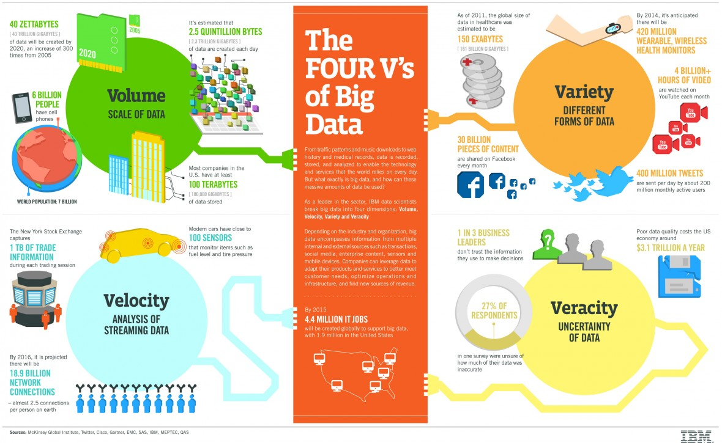
From IBM -http://www.ibmbigdatahub.com/infographic/four-vs-big-data

Slide 16


Name That Company…
What is the largest transportation company in the world?
How many vehicles do they own?
What company rents more rooms in the world than any other?
How many properties do they own?
Logos: http://blog.logomyway.com/history-of-uber-and-their-logo/ and https://www.entrepreneur.com/article/235709
Notes:
Answer to both questions…none!

Slide 17




Your Data are VERY Valuable!

Slide 18
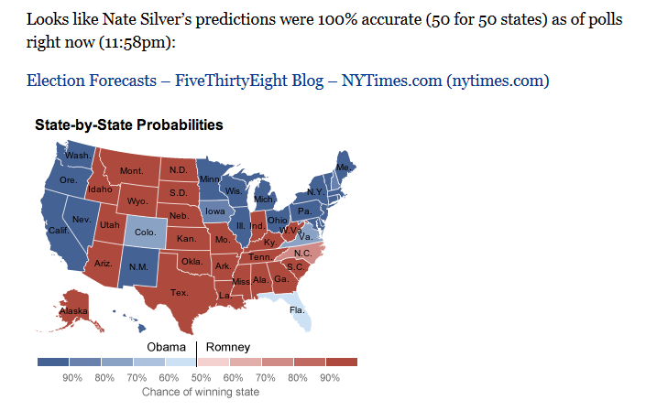
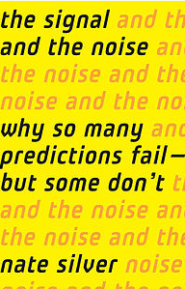
Nate Silver – US Election

Slide 19

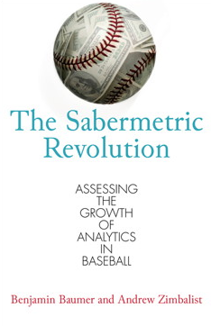

Sports Statisticians

Slide 20
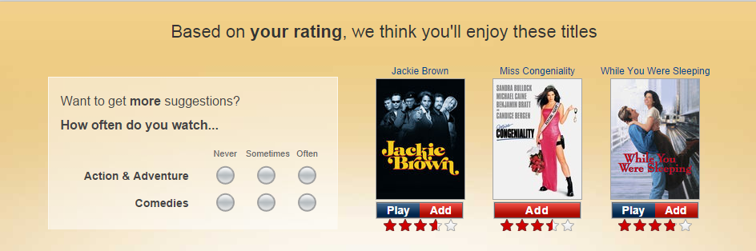
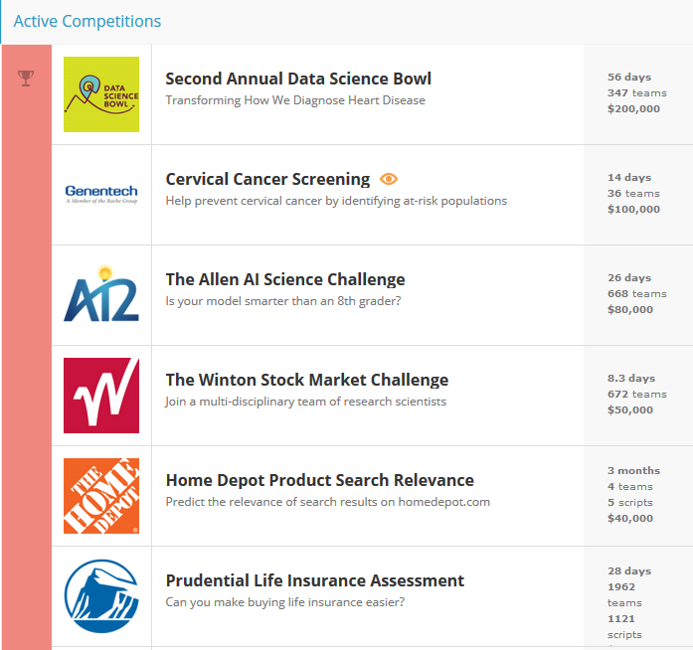
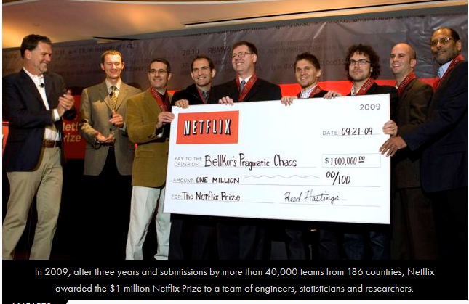
Data Competitions

Slide 21
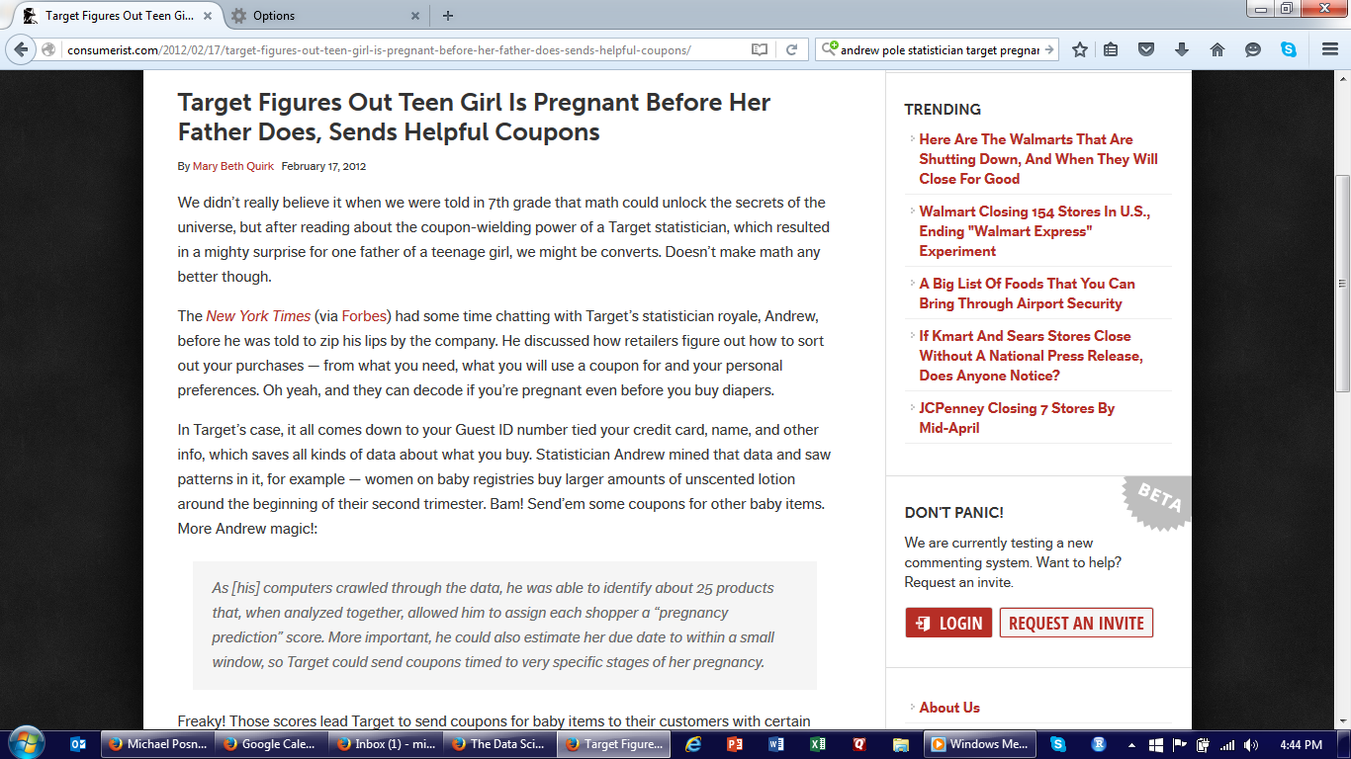
A Data Science Story…
Notes:
Add what DS doesn’t do well

